Slide 1
Wi-Fi:
Starspace 46 guest
Password:
Techlahoma

Slide 2
Techlahoma Hack Night in OKC
Thanks for joining us today! We're here thanks to volunteers and Techlahoma.

Slide 3
What is Techlahoma?
non-profit volunteer-run organization
hosts 33 groups and 2 conferences
sponsors free local events
supports the grassroots tech community of Oklahoma

Slide 4
Techlahoma.org
meetup.com/pro/Techlahoma
twitter.com/Techlahoma
donate.techlahoma.org/membership

Slide 5
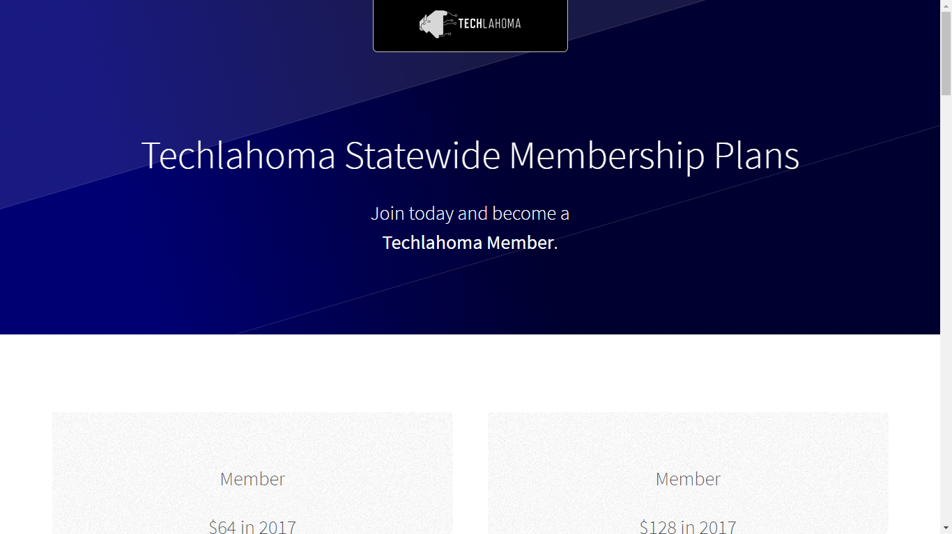
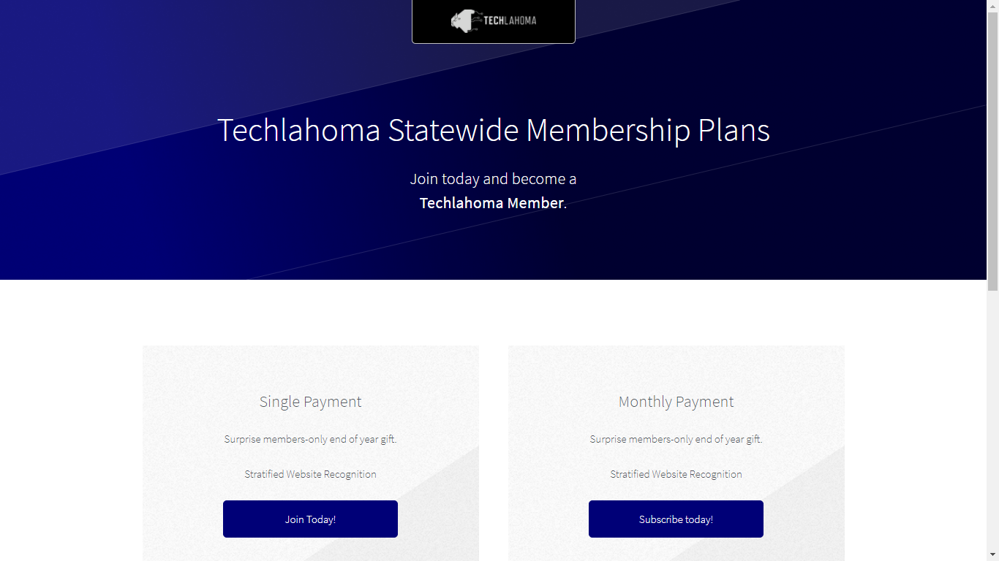

Slide 6
StarSpace46.com
starspace46.com/calendar-1
twitter.com/StarSpace46
Community membership $40/month

Slide 7
Twitch.tv/Techlahoma
Subscribe with Amazon Prime
Techlahoma gets a small donation from Amazon

Slide 8
Slack
techlahoma.org/spaces
#hacknight channel

Slide 9
DSN+DEV+OKC
Friday 1/5
6:00 - 9:00 pm
Creative and Tech Professional Mixer
meetup.com/dsn-dev-okc

Slide 10
Free Code Camp OKC
Sunday 1/7
2:00 - 3:00 pm
JavaScript Refresher
meetup.com/freecodecampokc

Slide 11
OKC#
Monday 1/8
11:30 - 12:30
Lightning Talks
meetup.com/okc-sharp

Slide 12
OKC Java
Tuesday 1/9
11:30 - 12:30
meetup.com/okcjug

Slide 13
OKC Python
Wednesday 1/10
11:30 - 12:30
Geospatial Data in MySQL with Python
meetup.com/okcpython

Slide 14
OKC Ruby
Thursday 1/11
11:30 - 12:30
meetup.com/okc-ruby

Slide 15
OKC Open Source Hardware
Saturday 1/13
2:00 - 4:00 pm
Meet Liger! A FOSS light switch for home automation/security
meetup.com/okc-osh

Slide 16
Free Code Camp OKC
Sunday 1/14
2:00 - 3:00 pm
Intro to APIs
meetup.com/freecodecampokc

Slide 17
OKC SQL
Monday 1/15
6:00 - 8:00 pm
meetup.com/okcsql

Slide 18
OKC JavaScript
Tuesday 1/16
11:30 - 12:30
meetup.com/okc-js

Slide 19
CocoaHeads OKC
Thursday 1/18
11:30 - 12:30
meetup.com/cocoaheads-okc

Slide 20
DevOps OKC
Friday 1/19
11:30 - 12:30
Lightning Talks
meetup.com/devopsokc

